Slide 1

Resale Flat Prices
Copyright © 2020. Smartcademy Pte. Ltd. All rights reserved.

Slide 2
Case Study of Resale Flat Prices
What are the changes in resale flat prices since 2017?
Where are the most affordable area for resale flat?
Which are the best area for investment?
Copyright © 2020. Smartcademy Pte. Ltd. All rights reserved.

Slide 3
Data
Data is taken from https://data.gov.sg/dataset/resale-flat-prices
Data is from January 2017 to January 2022
Data is based on date of registration for the resale transactions
There is a total of 118732 listing.
Copyright © 2020. Smartcademy Pte. Ltd. All rights reserved.

Slide 4
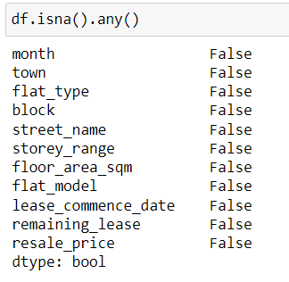
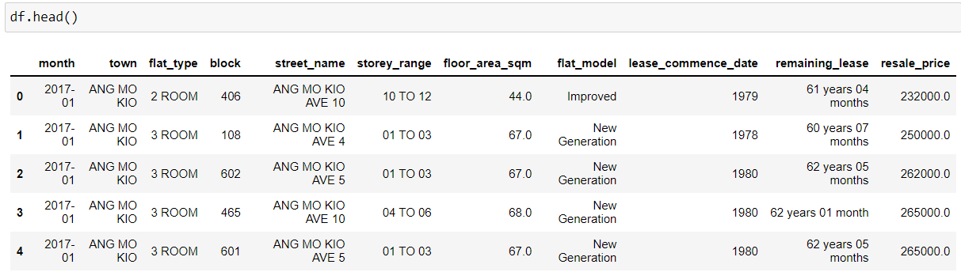
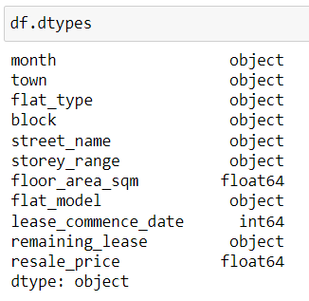
Exploratory Data Analysis (1/2)
This is how the data appears before any cleaning
Check for correct data type and any missing values.
Copyright © 2020. Smartcademy Pte. Ltd. All rights reserved.

Slide 5
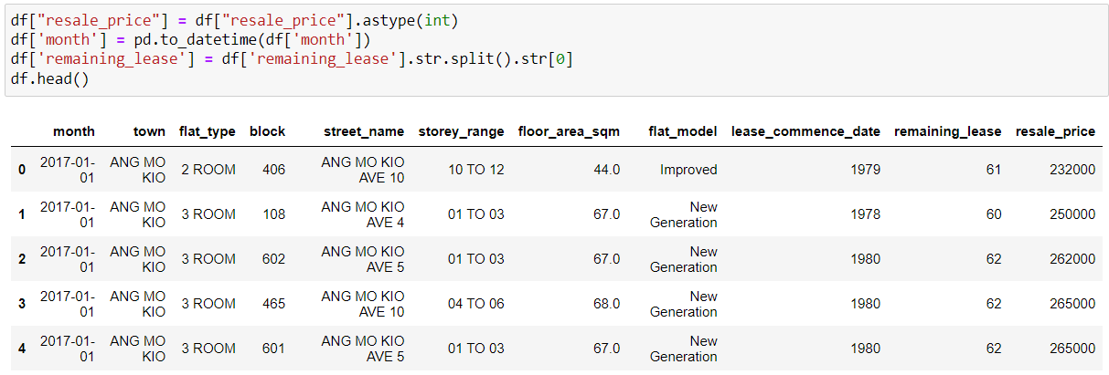
Exploratory Data Analysis (1/2)
resale_price converted to INT to get rid of demicals
month converted to datetime
remaining_lease to be split and return years value only
Copyright © 2020. Smartcademy Pte. Ltd. All rights reserved.

Slide 6
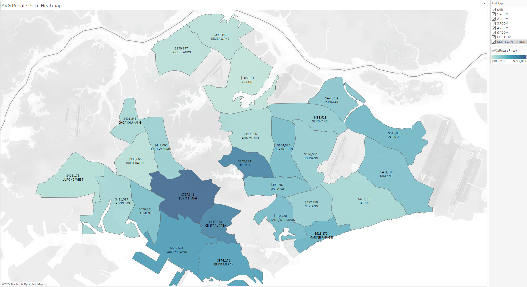
Exploratory Data Analysis (2/2)
Here is a map view of the average price of resale flats depending on location
Copyright © 2020. Smartcademy Pte. Ltd. All rights reserved.

Slide 7
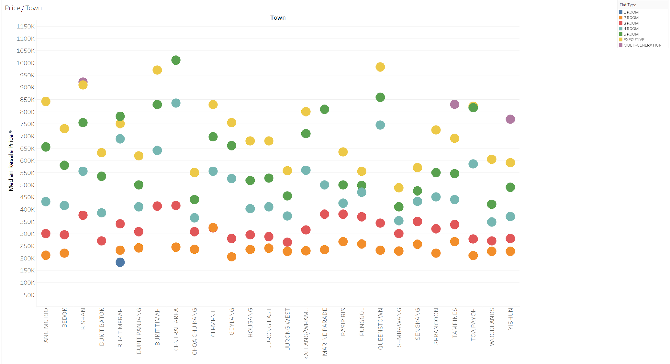
Exploratory Data Analysis (2/2)
Here we can see the median price of different flat types for each town.
Copyright © 2020. Smartcademy Pte. Ltd. All rights reserved.

Slide 8
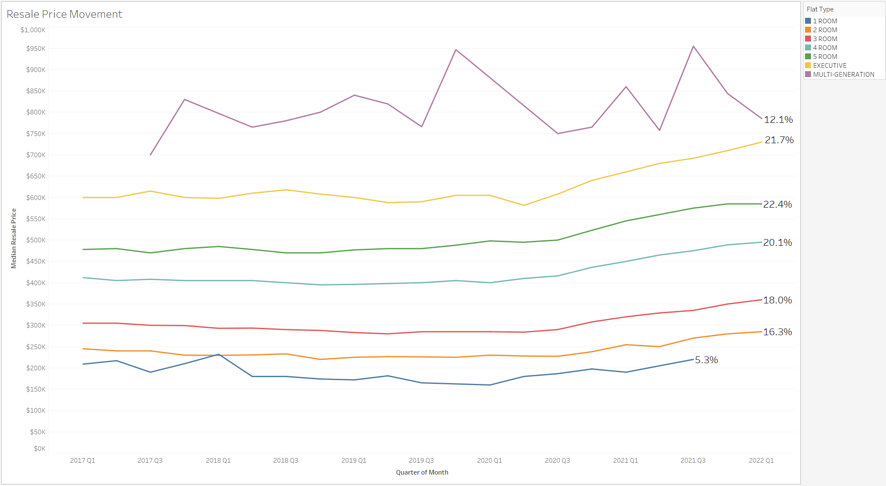
Exploratory Data Analysis (2/2)
Here we can see how much the resale price has changed since 2017 Q1.
Copyright © 2020. Smartcademy Pte. Ltd. All rights reserved.

Slide 9
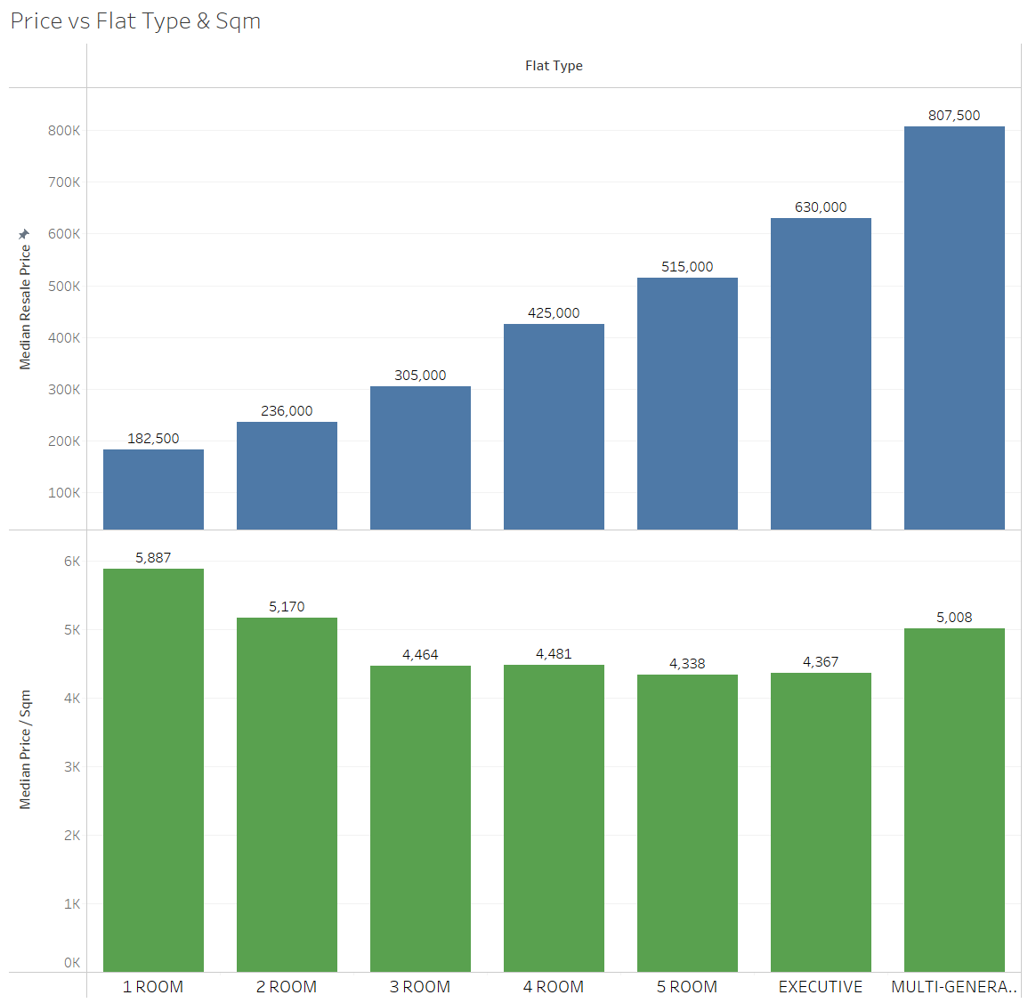
Exploratory Data Analysis (2/2)
Median Price of Resale Flats plotted against flat types and square metres(sqm)
1 Room and 2 Room flats cost more per sqm even though they cost lest than the others
Copyright © 2020. Smartcademy Pte. Ltd. All rights reserved.

Slide 10
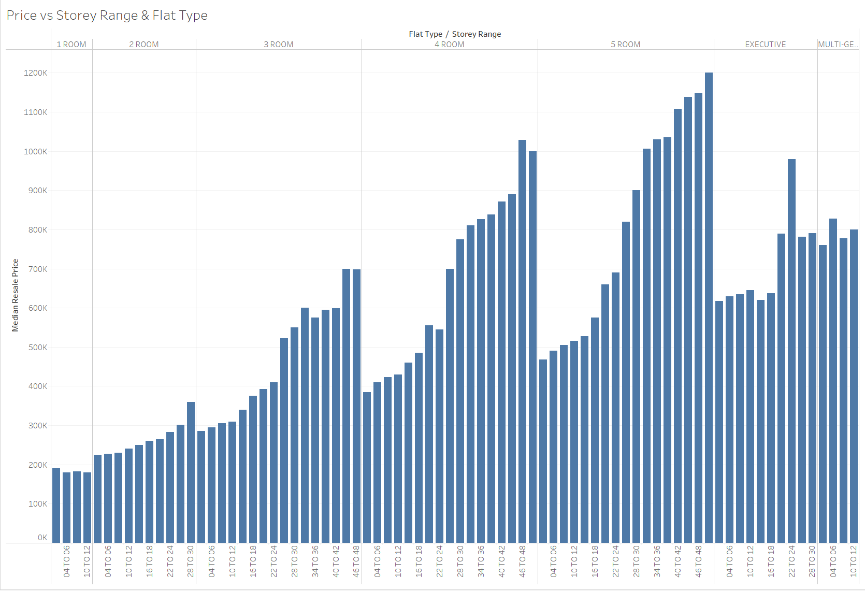
Exploratory Data Analysis (2/2)
Median Price of Resale Flat plotted against storey range and flat type
Copyright © 2020. Smartcademy Pte. Ltd. All rights reserved.

Slide 11
Dashboard
https://public.tableau.com/app/profile/zion1072/viz/Capstone_16434486425550/Story1?publish=yes
Copyright © 2020. Smartcademy Pte. Ltd. All rights reserved.

Slide 12
Strategy: Key Recommendations
Which are the most affordable area for resale flats?
Ranking from most to least affordable - North, West, East, South and Central Area.
It is not recommended to purchase a 1 Room flat because they have the least resale value of 5.3% even though they are the cheapest.
Flats that are on lower floor will be cheaper than those on higher floors, this applies for 2 to 5 Room flats.
The recommendation for most affordable area for resale flats will be flats located in the North with lower floors.
Copyright © 2020. Smartcademy Pte. Ltd. All rights reserved.

Slide 13
Strategy: Key Recommendations
Which are best area for investment?
Top 3 Highest growth in resale flats price since 2017 Q1
- 5 Room, 22.4%
- Executive, 21.7%
- 4 Room, 20.1%
We will analyse these 3 type of flats in each town to determine best area
Copyright © 2020. Smartcademy Pte. Ltd. All rights reserved.

Slide 14
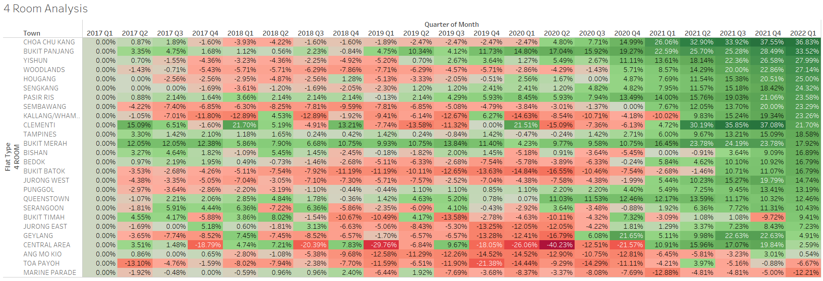
Strategy: Key Recommendations
Here we analyse the % increase for median prices of 4 room resale flats
Copyright © 2020. Smartcademy Pte. Ltd. All rights reserved.

Slide 15
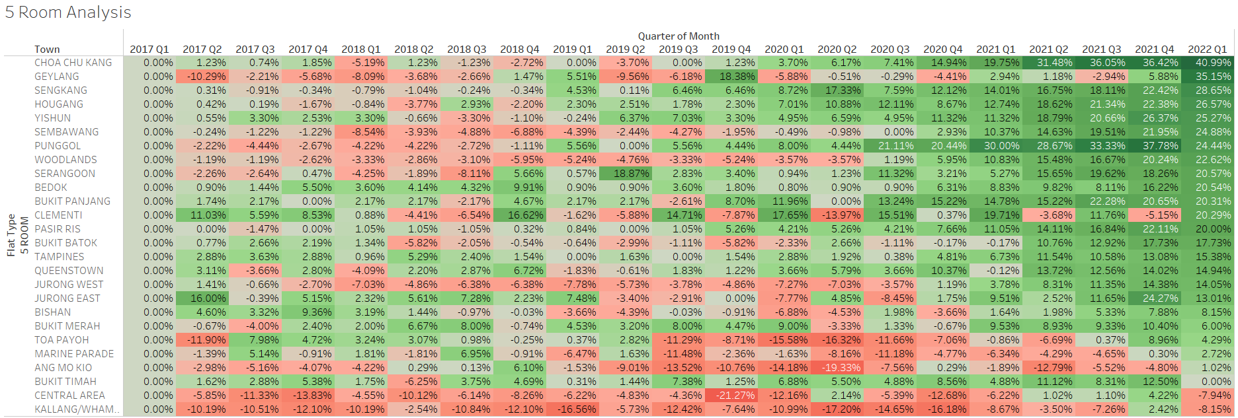
Strategy: Key Recommendations
Here we analyse the % increase for median prices of 5 room resale flats
Copyright © 2020. Smartcademy Pte. Ltd. All rights reserved.

Slide 16
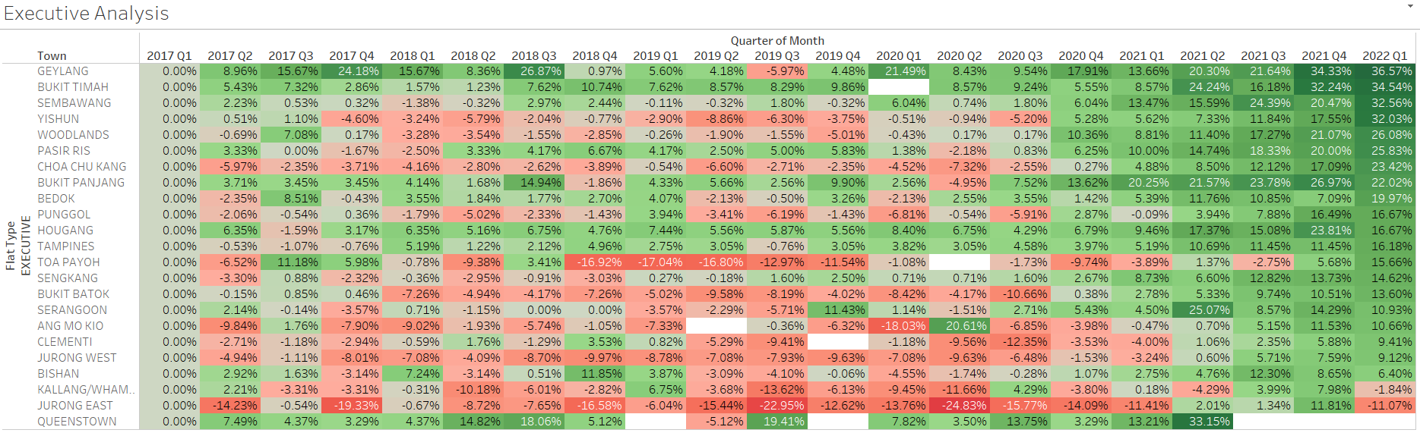
Strategy: Key Recommendations
Here we analyse the % increase for median prices of executive resale flats
Copyright © 2020. Smartcademy Pte. Ltd. All rights reserved.

Slide 17
Strategy: Key Recommendations
Which are best area for investment?
We can see that since 2017, the prices of Choa Chu Kang flats has been increasing the fastest
Other areas that also increasing a fast rate are Yishun, Hougang and Sengkang, located in the north-east.
The recommendation for the best area for investment will be Choa Chu kang.
Copyright © 2020. Smartcademy Pte. Ltd. All rights reserved.

Slide 18
Conclusion
The most affordable area for resale flats will be at the North with lower floors.
The best area for investment will be Choa Chu Kang.
However, median prices of resale flats are also affected by the development of the area and government policies. Buyers have to take these into consideration when deciding on a resale flat.
Data analysis has identified Choa Chua Kang to be the best area of investment but there could be better options with more data on the development of the area.
Copyright © 2020. Smartcademy Pte. Ltd. All rights reserved.

Slide 19
THANK YOU
Copyright © 2020. Smartcademy Pte. Ltd. All rights reserved.

